Slide 1

AGRIMETRIX:
CUTTING EDGE DEVICE FOR PRECISION SOIL TESTING AND NUTRIENT MANAGEMENT
Ishani Bhowmick, Soumyadip Debnath
Department: B. Tech In Computer Science And Engineering (Internet Of Things, Cyber Security Including Block Chain Technology)
College: Future Institute Of Technology
Mentor: Prof. Samiran Basak (Assistant Professor, Future Institute Of Technology)

Slide 2
CONTENTs
Introduction
Problem Definition
Societal Importance
Existing Models
Solution Overview
Project Demonstration
Technical Details
Methods To Assess Soil Ph In The Field
Methods To Assess Soil Moisture In The Field
Soil Nutrient Index Values
Soil Erosion Score
Procedure (FLOWCHART)
Visual Representation Of The Device
Novelty
Challenges
Future Scopes
Component List & Budget
Target Beneficiaries
Commercialization Strategy
Sample Revenue Model
Conclusion
Acknowledgement
Reference

Slide 3
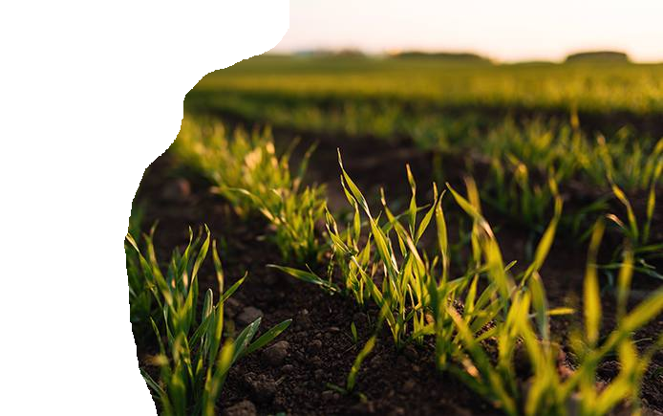
INTRODUCTION
“We know more about the movement of celestial bodies than about the soil underfoot.”

Slide 4
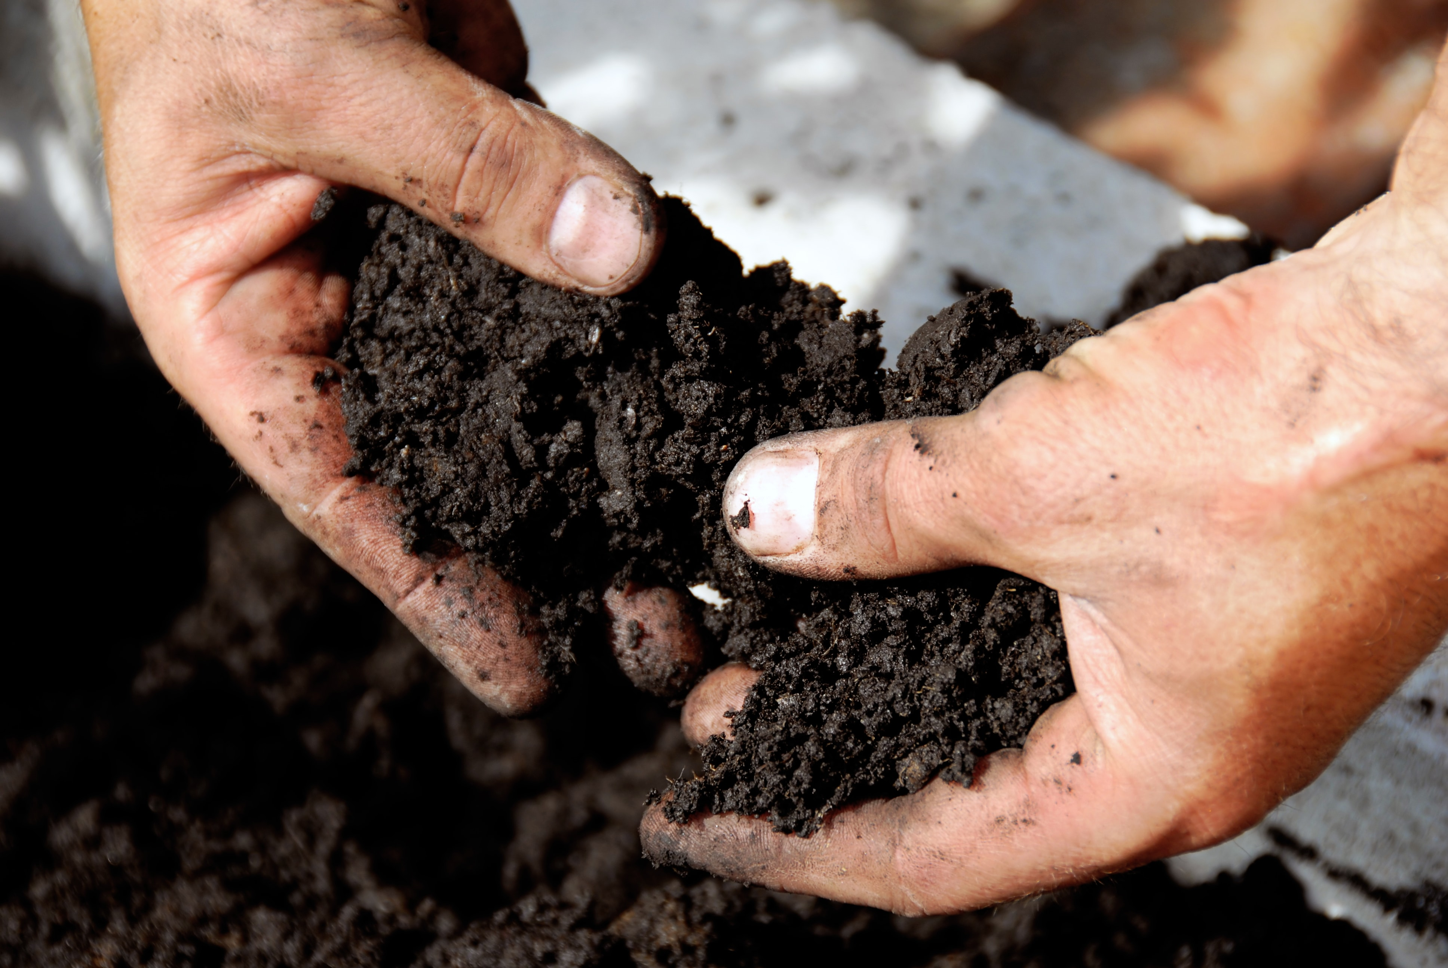
Problem definition
Challenges like erosion, compaction, nutrient depletion, and chemical contamination impact soil quality. Interconnectedly, water management, climate change, biodiversity loss, and pest control relate to soil health.

Slide 5
SOCIETAL IMPORTANCE OF THE PROBLEM
Lack of Precision Farming Implementation
No Data Integration and Interoperability
Resource Inefficiency & Labour Shortages
Inefficient Pest and Disease Management
Improper Soil Health Management
Low access to Information and Training
Problems in Rural Connectivity & Market Reach
Challenges faced by farmers of India

Slide 6
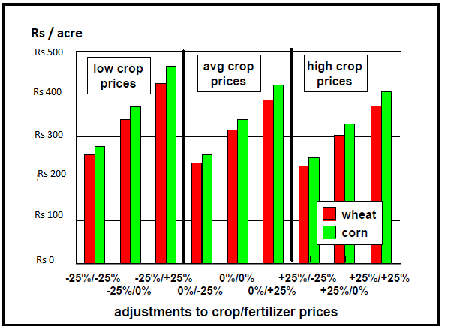
Gross value of soil test information across 10,000 fields at adjustments to crop and fertilizer prizes (UTTAR PRADESH, 2018)

Slide 7
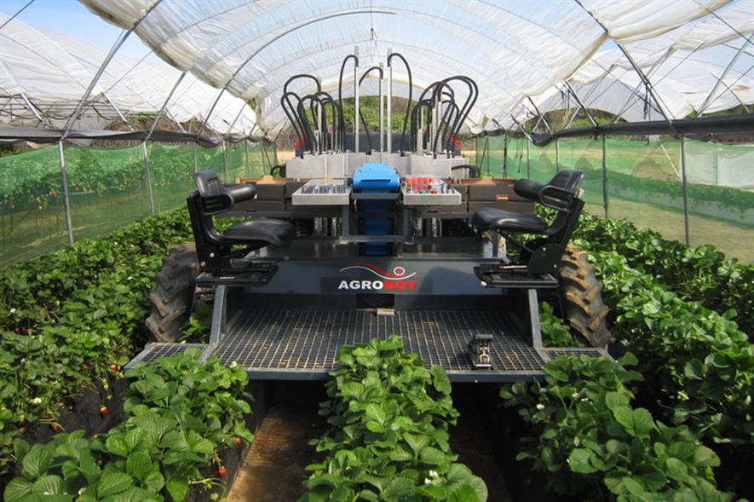
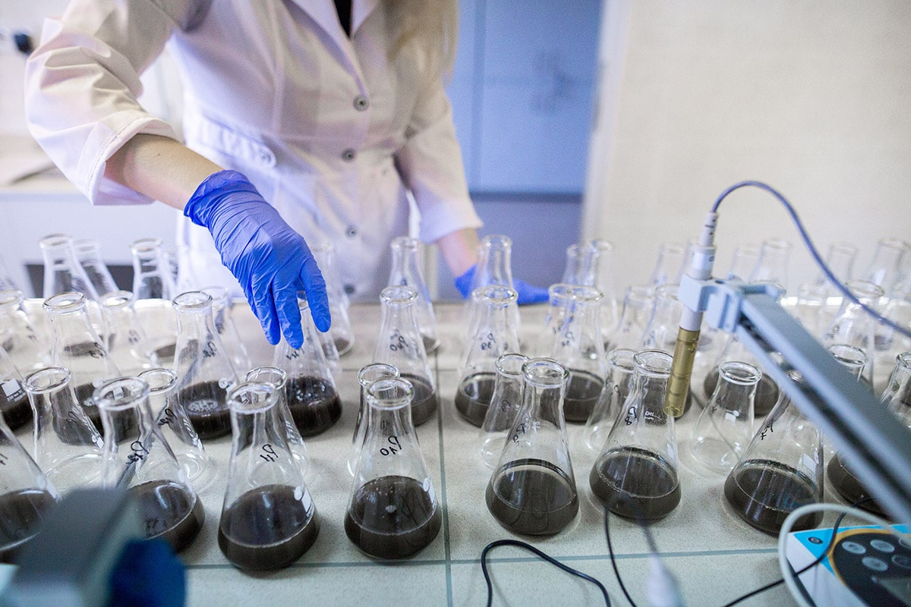
EXISTING METHODS
WE HAVE 14 CRORE FARMERS IN INDIA, BUT WE HAVE HARDLY 3000 LABS FOR SOIL TESTING

Slide 8
Solution overview
This project tackles agricultural information gaps by creating a portable device with integrated pH, moisture, conductivity, and NPK sensors.
It offers real time soil property insights, replacing time consuming lab methods.
Farmers can swiftly make informed decisions on fertilization, irrigation, and soil health for better yields and sustainable practices, overcoming challenges of on site soil analysis.

Slide 9
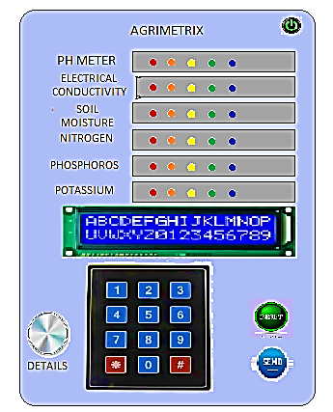
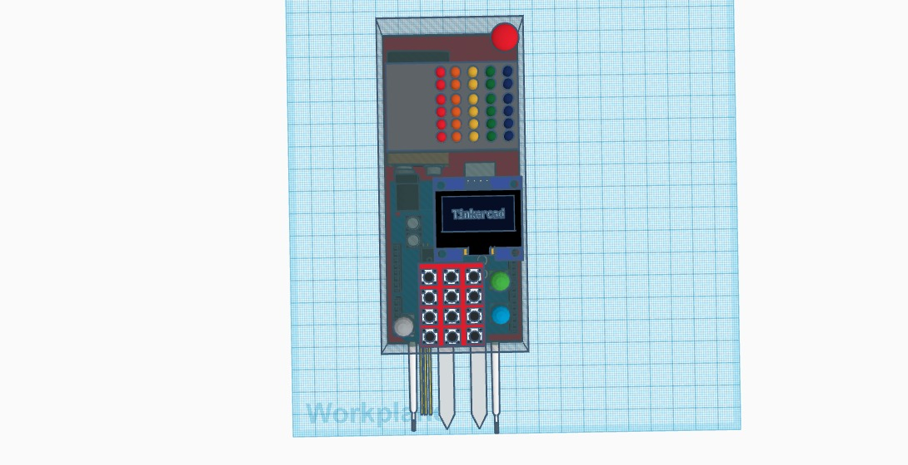
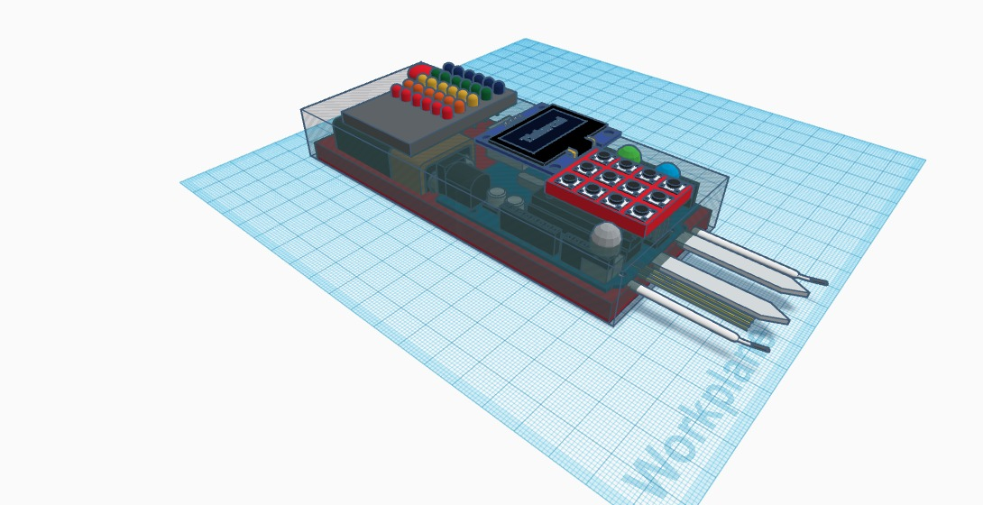
VISUAL REPRESENTATION OF THE DEVICE

Slide 10
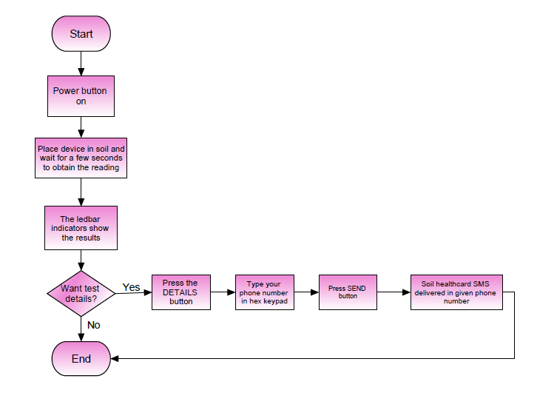
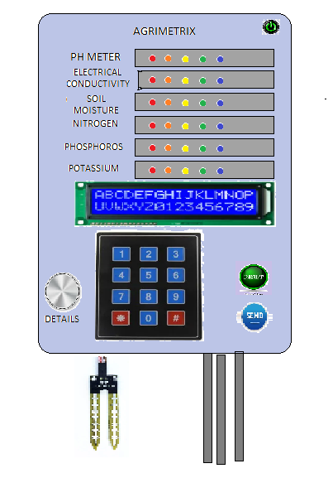
Procedure (FLOWCHART)

Slide 11
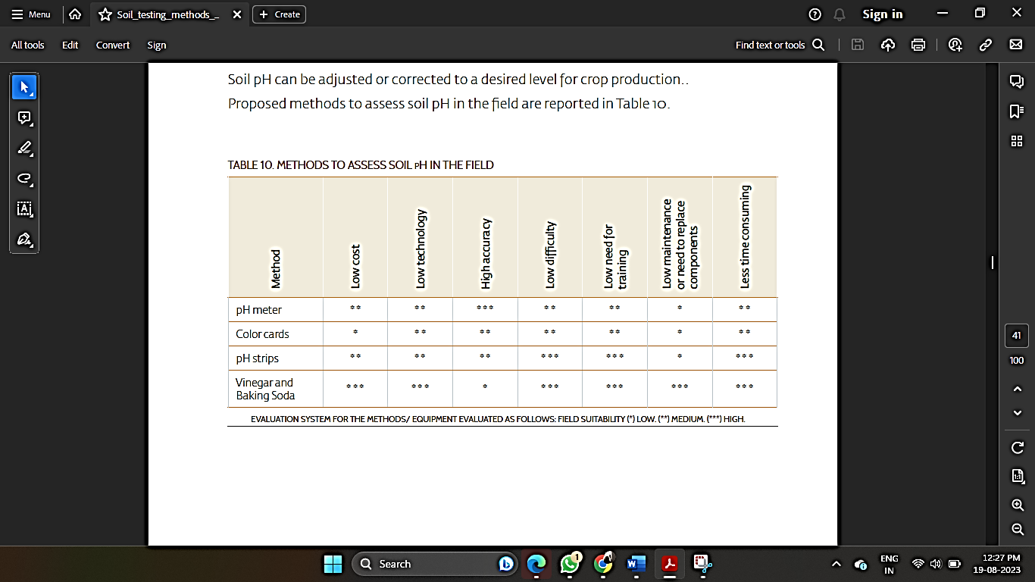
METHODS TO ASSESS SOIL PH IN THE FIELD

Slide 12
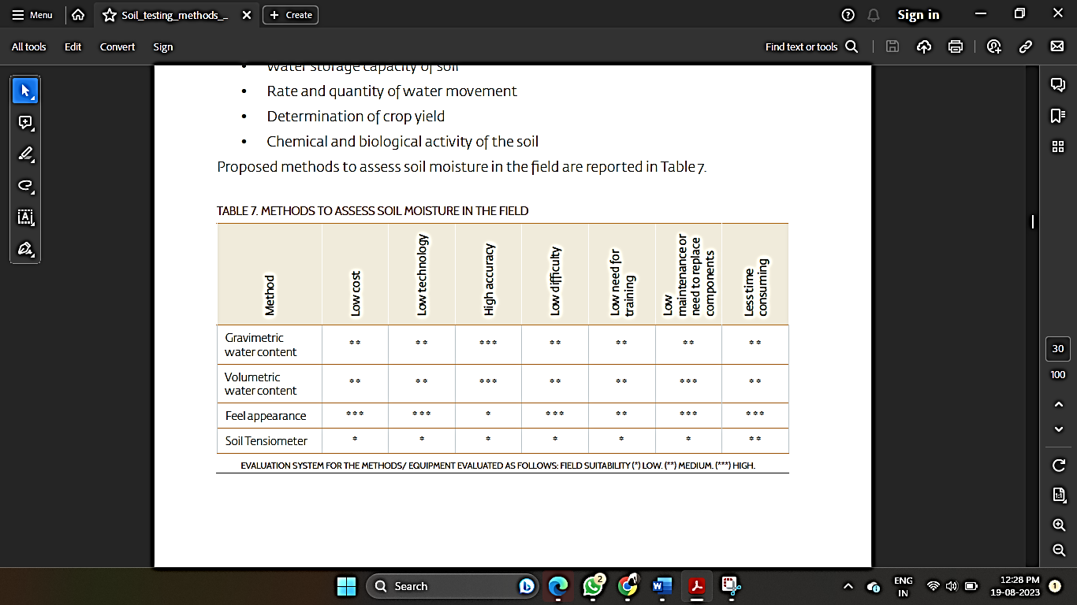
METHODS TO ASSESS SOIL MOISTURE IN THE FIELD

Slide 13
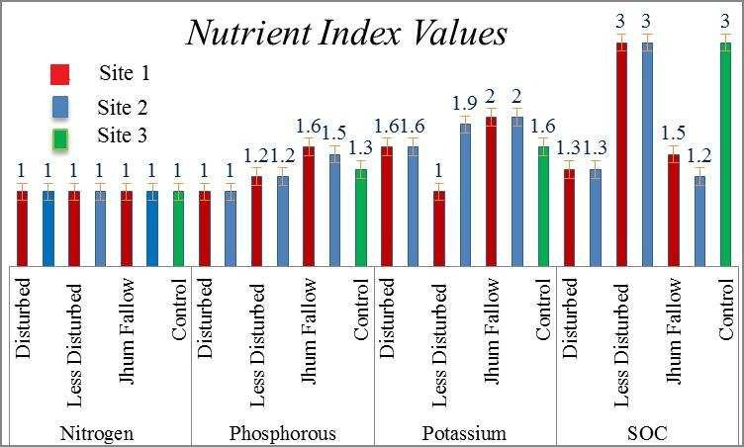
SOIL NUTRIENT INDEX VALUES
Status of Soil Nutrients and fertility of three land use system in Raid-Marwet Region, Ri-Bhoi district of Meghalaya, India (2016)

Slide 14
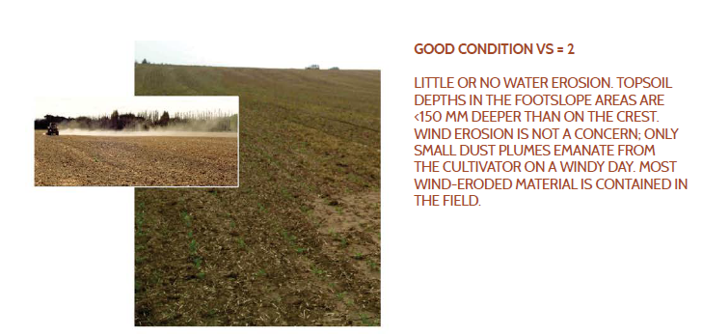
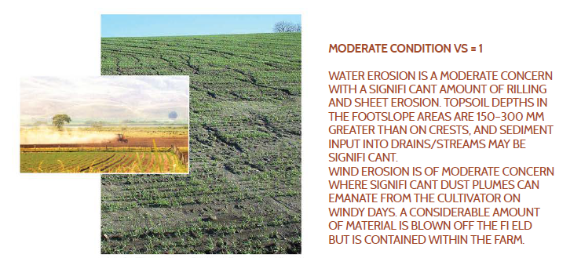
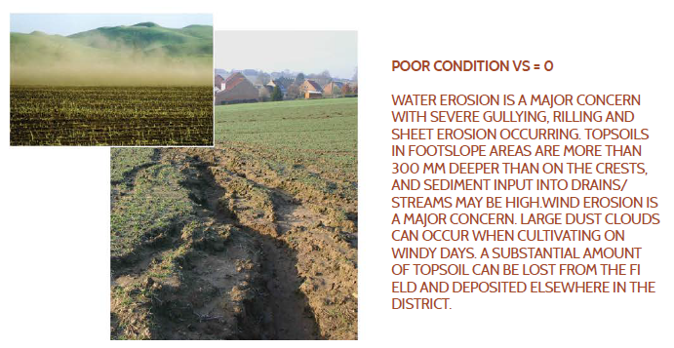
SOIL EROSION SCORE

Slide 15
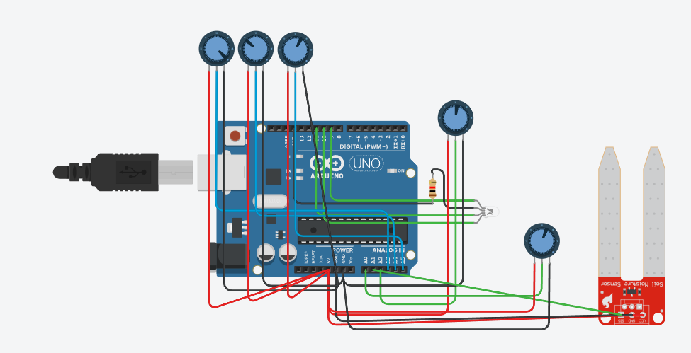
CIRCUIT EXPLANATION

Slide 16
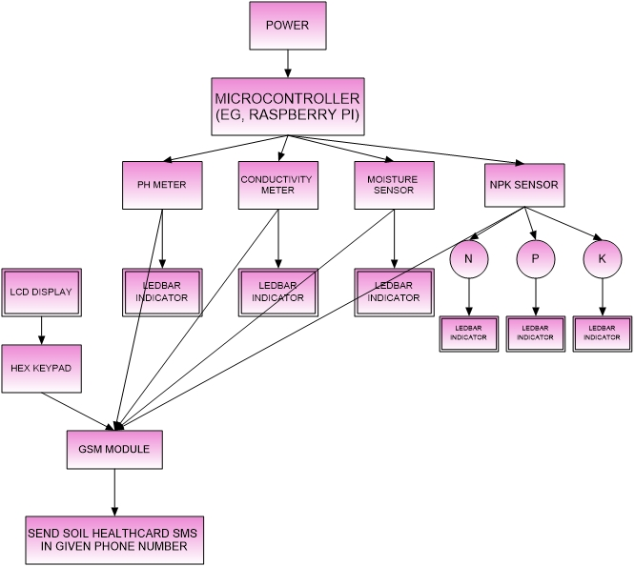
Technical details
Block diagram of the circuit implemented in the device

Slide 17
Novelty in this gadget
Proposed Agriculture Device With Integrated Sensors
pH, Moisture, Conductivity, NPK Sensors
Portability, User Friendliness, Sensor Integration
Real Time Readings Via Mixed Soil Water Sample
Cost Effective Alternative To Lab Testing
Additional Features: Data Logging, Wireless Connectivity
Soil Condition Tracking, Data Driven Decisions
Optimization Of Agricultural Practices

Slide 18
Target beneficiaries
Target Beneficiaries
Farmers
Agricultural Consultants
Agricultural Researchers
Agricultural Extension Services
Environmental Conservation Organizations
Government Agencies and NGOs

Slide 19
PROJECT DEMONSTRATION
Sampling and Preparation
Measurement Process
Results Display and Interpretation
pH Sensor
Moisture Sensor
Conductivity Meter
NPK Sensor
Additional Features
Data Logging
Wireless Connectivity
Calibration and Maintenance

Slide 20

Future scopes
Implement logging details
After sales services
Collaborations/ partnerships
Durability and Reliability
Battery Life
Cost Efficiency
Data Storage and Security
Feedback Mechanism
Localization
Maintenance and Repairs

Slide 21
challenges
Limited Access to Testing Services
Lack of Awareness
Language and Literacy Barriers
Variability of Soil
Lack of Resources

Slide 22
Component list & Budget
Container for the device circuit: 1,000
pH Sensor: 6,000
Conductivity meter: 1,000
Hygrometer: 1,000
NPK sensor: 7,000
Misc.: 1500
UNO R3: 500
Total (approximate):
18,000

Slide 23

COMMERCIALISATION STRATEGY
Market Research
Product Positioning
Marketing and Promotion
Distribution and Sales Channels
Customer Support and Training

Slide 24

SAMPLE REVENUE MODEL
Device Sales
Subscription Model
Service and Maintenance
Data Analytics and Insights
Licensing and Partnerships
Expansion and Product Line Diversification

Slide 25
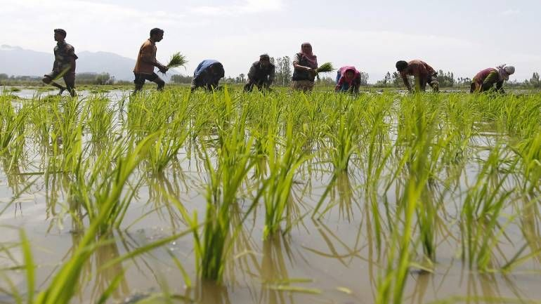
CONCLUSION
Why Agrimetrix?
Portable, affordable, easy to use
Increase awareness about soil among farmers
Check six parameters like moisture, pH, electrical conductivity, nitrate, potassium, and phosphate contents
Results in hand within 25 – 30 seconds
Soil health card instantly generated in mobile phones
Reduce the cost of soil testing from Rs500 at a private lab to Rs200
Pocket size device for farmers to check soil health

Slide 26
ACKNOWLEDGEMENTS
I extend my heartfelt gratitude to my exceptional team member, Soumyadip whose dedication, expertise, and tireless efforts have been instrumental in the successful execution of this project. Your collaborative spirit and resilience in the face of challenges have been truly inspiring. I am deeply appreciative of the invaluable guidance and mentorship provided by Prof. Samiran Basak. This achievement stands as a testament to the power of teamwork and mentorship.

Slide 27
REFERENCE
Doran, J.W., Stamatiadis, S.I. & Haberern, J. 2002. Soil health as an indicator of sustainable management. Agriculture, Ecosystems & Environment
Arunachalam, P., Kannan, P., Prabukumar, G. and Govindaraj, M. 2013. Zinc deficiency in Indian soils with special focus to enrich zinc in peanut. African Journal of Agricultural Research
Claire, J. Glendenning, Suresh Chandra Babu and KwadwoAsenso-Okyere, 2019. Extension through entrepreneurial approach: evaluating the agriclinics program. Agricultural Extension Reforms in South. Status, Challenges, and Policy Options
DACMAGI (Department of Agriculture & Cooperation Ministry of Agriculture Government of India), 2011. Soil Testing in India. Krishi Bhawan, New Dehli
JG, R., Estefan, G. & Rashid, A. 2002. Soil--Plant-AnalysisSoil and Plant Analysis Laboratory Manual
Kalra, Y.P. 1995. Determination of pH of Soils by Different Methods: Collaborative Study Journal of AOAC INTERNATIONAL
Food and Agriculture Organization of the United Nations, 2020. Soil testing methods - Global Soil Doctors Programme: A farmer-to-farmer training programme

Slide 28

Thank you

